Slide 1
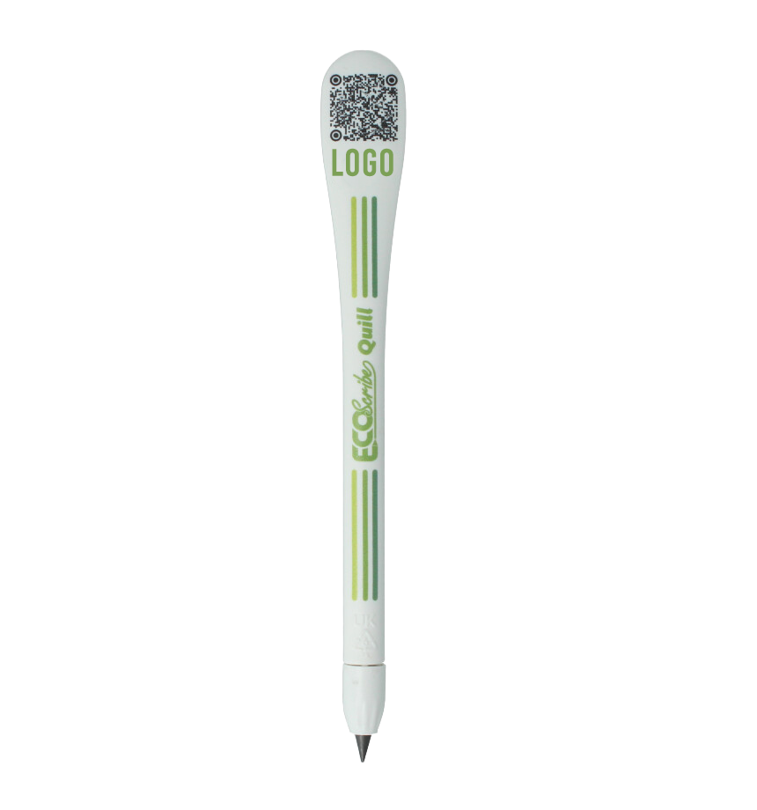

ECOSCRIBE | SALES GUIDE
The Promotional Writing Instrument
Reinvented.
Graphene writing technology.
Genuine sustainability credentials.
Branded promotional merchandise
that outlasts, outperforms, and stands apart.
ADD YOUR LOGO & BRAND DETAILS HERE

Slide 2

THE PROBLEM WITH CONVENTIONAL PENS
Most promotional pens are made from virgin plastic, rely on petroleum-based ink, and are built to be thrown away. In an era where sustainability credentials matter, they carry a reputational cost as well as an environmental one.
Virgin Plastic
Petroleum Ink
Designed to Fail
Standard pens are manufactured from new fossil fuel resources, with no recycled content and no end-of-life story.
Ink cartridges rely on petrochemical production, create hazardous waste, and are largely unrecyclable.
Short lifespan means rapid disposal - and your brand associated with landfill rather than longevity.
There is a better option - one that eliminates ink entirely.

Slide 3
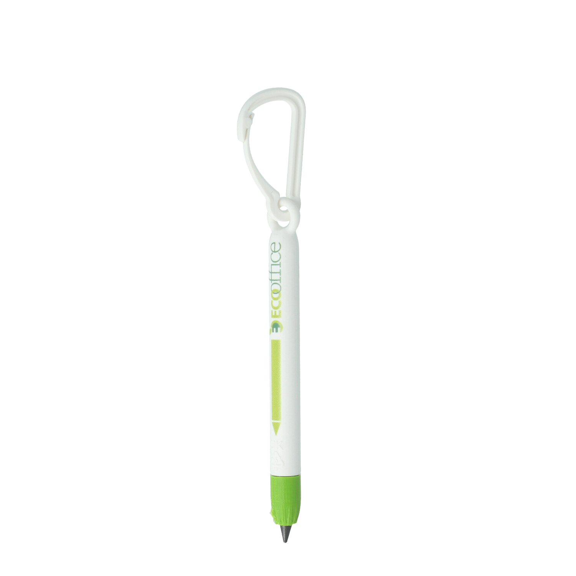

WHAT IS ECOSCRIBE?
A promotional writing instrument that writes without ink.
EcoScribe uses advanced graphene technology - transferring material through oxidation rather than depositing liquid ink. The result is a consistent, permanent graphite-grey mark, produced without a single drop of petroleum-based ink. Although the look when written on paper is similar in appearance to graphine pencils, these graphite nibs last for years without the need for sharpening or replacement.
EcoScribe
Graphene
Writing
Instruments
15,000m
100×
writing distance per pen
lifespan of a standard ballpoint
0
100%
ink cartridges — ever
recycled plastic body

Slide 4


THE GRAPHENE DIFFERENCE
How graphene writing technology works - and why it matters for your customers.
No ink - no petroleum
Writes through material transfer, eliminating petroleum-based ink production, use, and disposal entirely.
Never dries out, leaks, or fails
No ink means no maintenance. Functions reliably across extreme temperature ranges - from freezer to desert.
Equivalent to 100 ballpoint pens
Each EcoScribe writes approximately 15,000 metres - delivering exceptional brand exposure for your customer.
User-serviceable twist-off nib
Replace the nib or body independently. Extends product life, reduces waste, and avoids whole-scribe disposal.

Slide 5
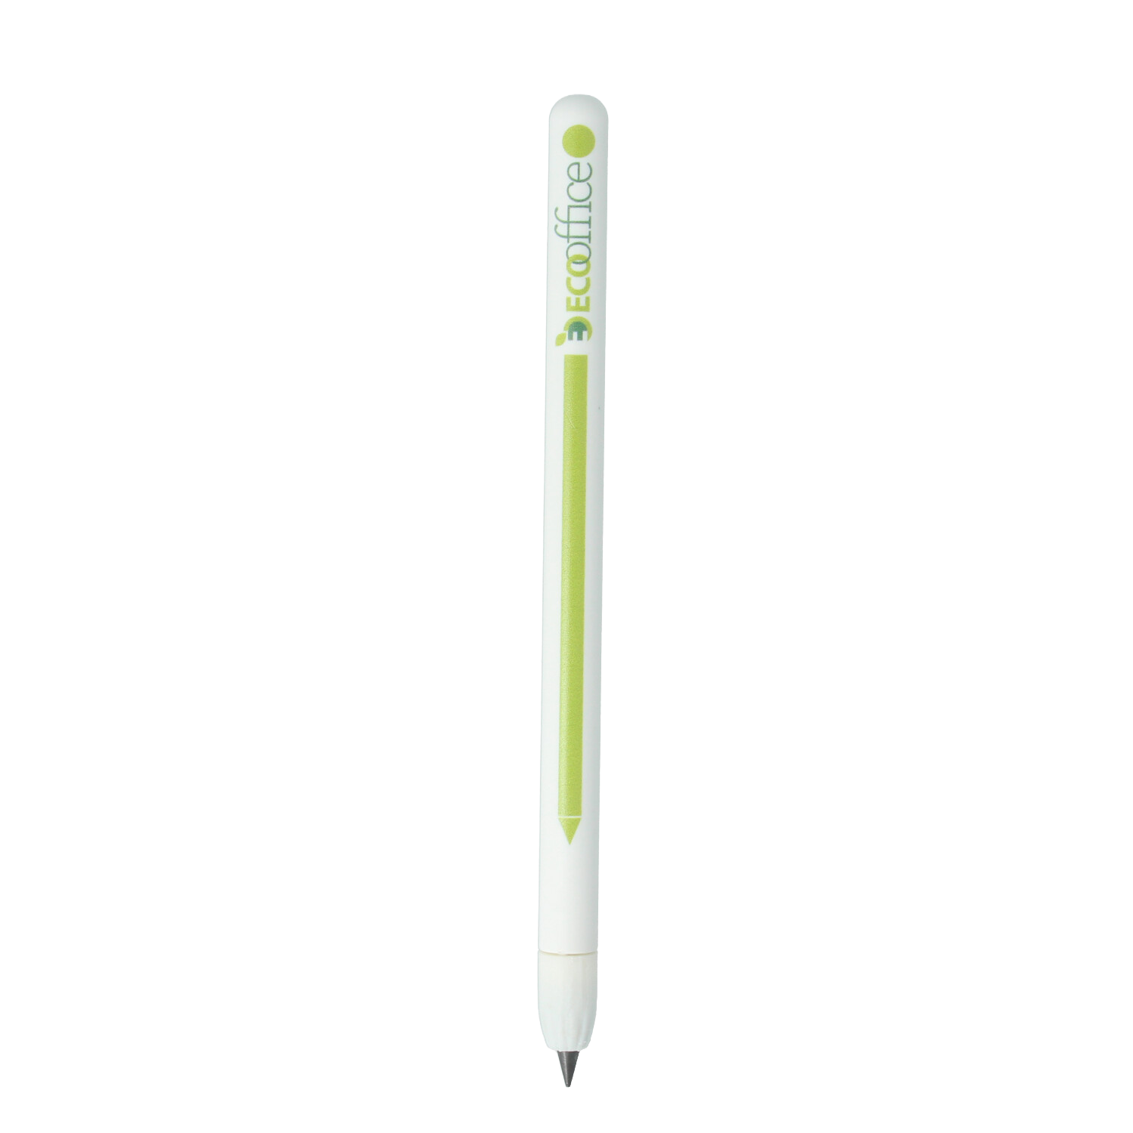
CIRCULAR DESIGN PRINCIPLES
EcoScribe is built for end-of-life, not end-of-use.
Recycled construction
Body manufactured from 100% recycled plastic. R+ option adds biodegradable credentials.
Single-material design
Unlike multi-component pens with metal springs and adhesives, EcoScribe uses one material type - enabling effective recycling without complex separation.
Designed
for the
Circular
Economy
Twist-off nib system
Replace only the component that wears. Simple separation at end-of-life for proper material recovery - no tools required.
No cartridge waste
Zero ink cartridges means zero cartridge disposal across the entire product lifetime.

Slide 6
CHOOSE YOUR MATERIAL
Both options feature recycled plastic construction and genuine sustainability credentials.
Recycled Plastic
R+ (Recycled+)
The standard. Proven. Trusted.
Going further. Biodegradable additive included.
100% post-consumer recycled plastic body
Available in white as standard for full-colour print
7 material colour options plus Pantone matching
Competitively priced - no sustainability premium
Zero waste, solar powered production
Recycled, recyclable, AND biodegradable credentials
Biodegradable additive accelerates end-of-life breakdown
'Tor' colour priced the same price as standard recycled range - no added cost
4 additional speckled colour options available
Zero waste, solar powered production

Slide 7
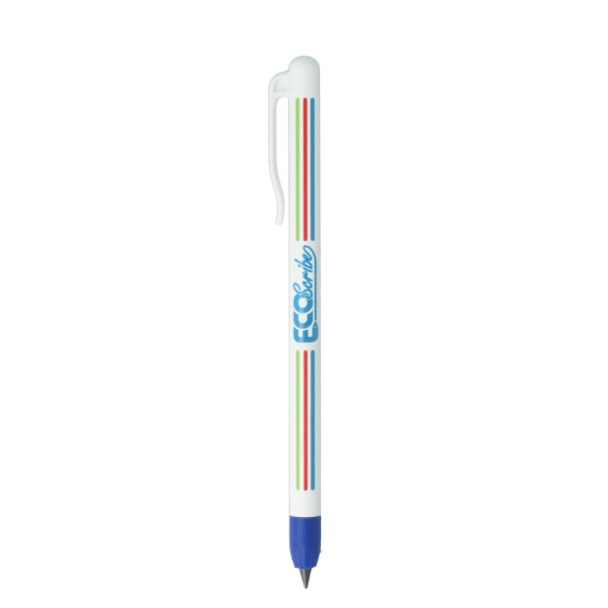
WHY ECOSCRIBE
DELIVERS MORE
Promotional merchandise that works harder - for longer.
100×
longer lifespan than standard ballpoints
Extended
brand visibility across the full product life
Zero
ink-related failures, dried-out pens, or leaks

Slide 8


POSITION YOUR BRAND AS A SUSTAINABILITY LEADER
Choosing EcoScribe tells your customers something important about your organisation.
Genuine Commitment
Circular Economy
Investment in products designed for longevity - not disposability. Sustainability that goes beyond surface-level material claims.
Supporting products designed for repair, reuse, and recycling. An end-of-life story your customers can stand behind.
Conversation Starter
Informed Decision-Making
Graphene writing technology generates genuine interest. A promotional item people will mention, keep, and use - not discard.
Demonstrating that sustainability extends beyond the obvious - into the writing mechanism itself. Credibility through detail.

Slide 9
CUSTOMISATION OPTIONS
Technical
Specifications
EcoScribe is fully brandable, with a range of options to match your identity.
Print customisation
Writing distance
~15,000 metres
Full-colour CMYK print for your corporate identity, logo, and messaging.
Equivalent to
~100 ballpoint pens
Colour options
White as standard for clean print results. Multiple material colours available, including Pantone matching.
Material
Recycled plastic or R+
R+ upgrade
Construction
Single-material body
Specify R+ biodegradable formulation at no additional cost for enhanced sustainability credentials.
Mark colour
Graphite-grey
Product variations
Maintenance
None required
Available in Classic (a classic shape), Clip (with built-in clip), Mini (short with plastic carabiner) & Scribe (widened end with space for QR code), giving you a wide variety of shapes for different industry and branding needs.
Temperature
Extended vs liquid ink
Recyclability
Full component separation

Slide 10
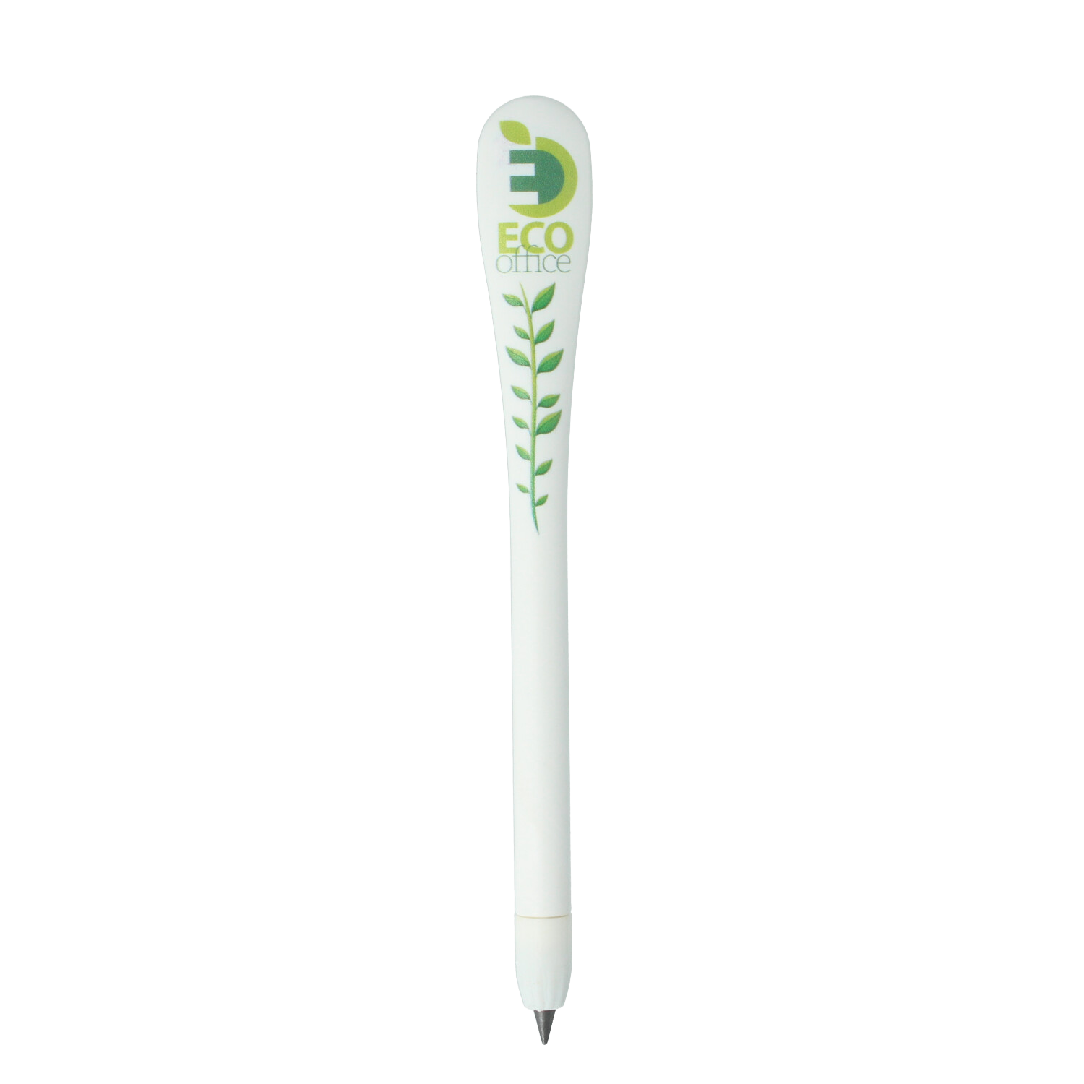
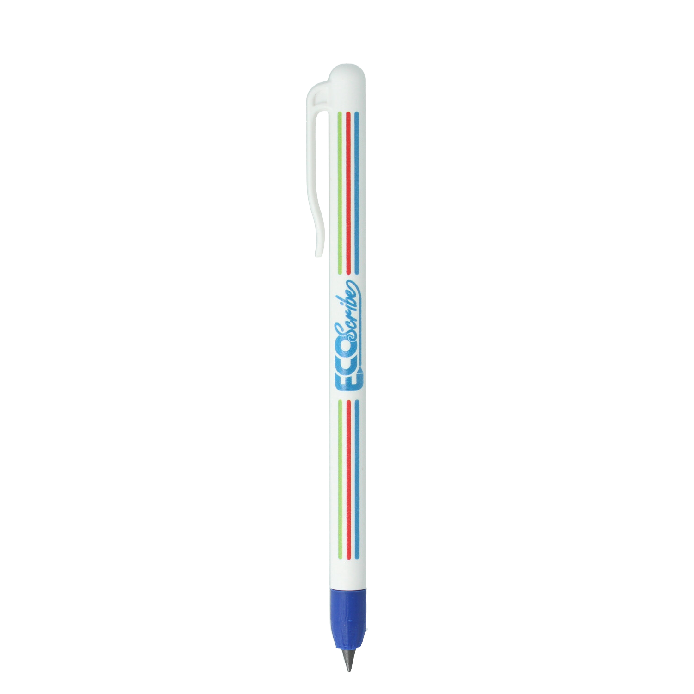
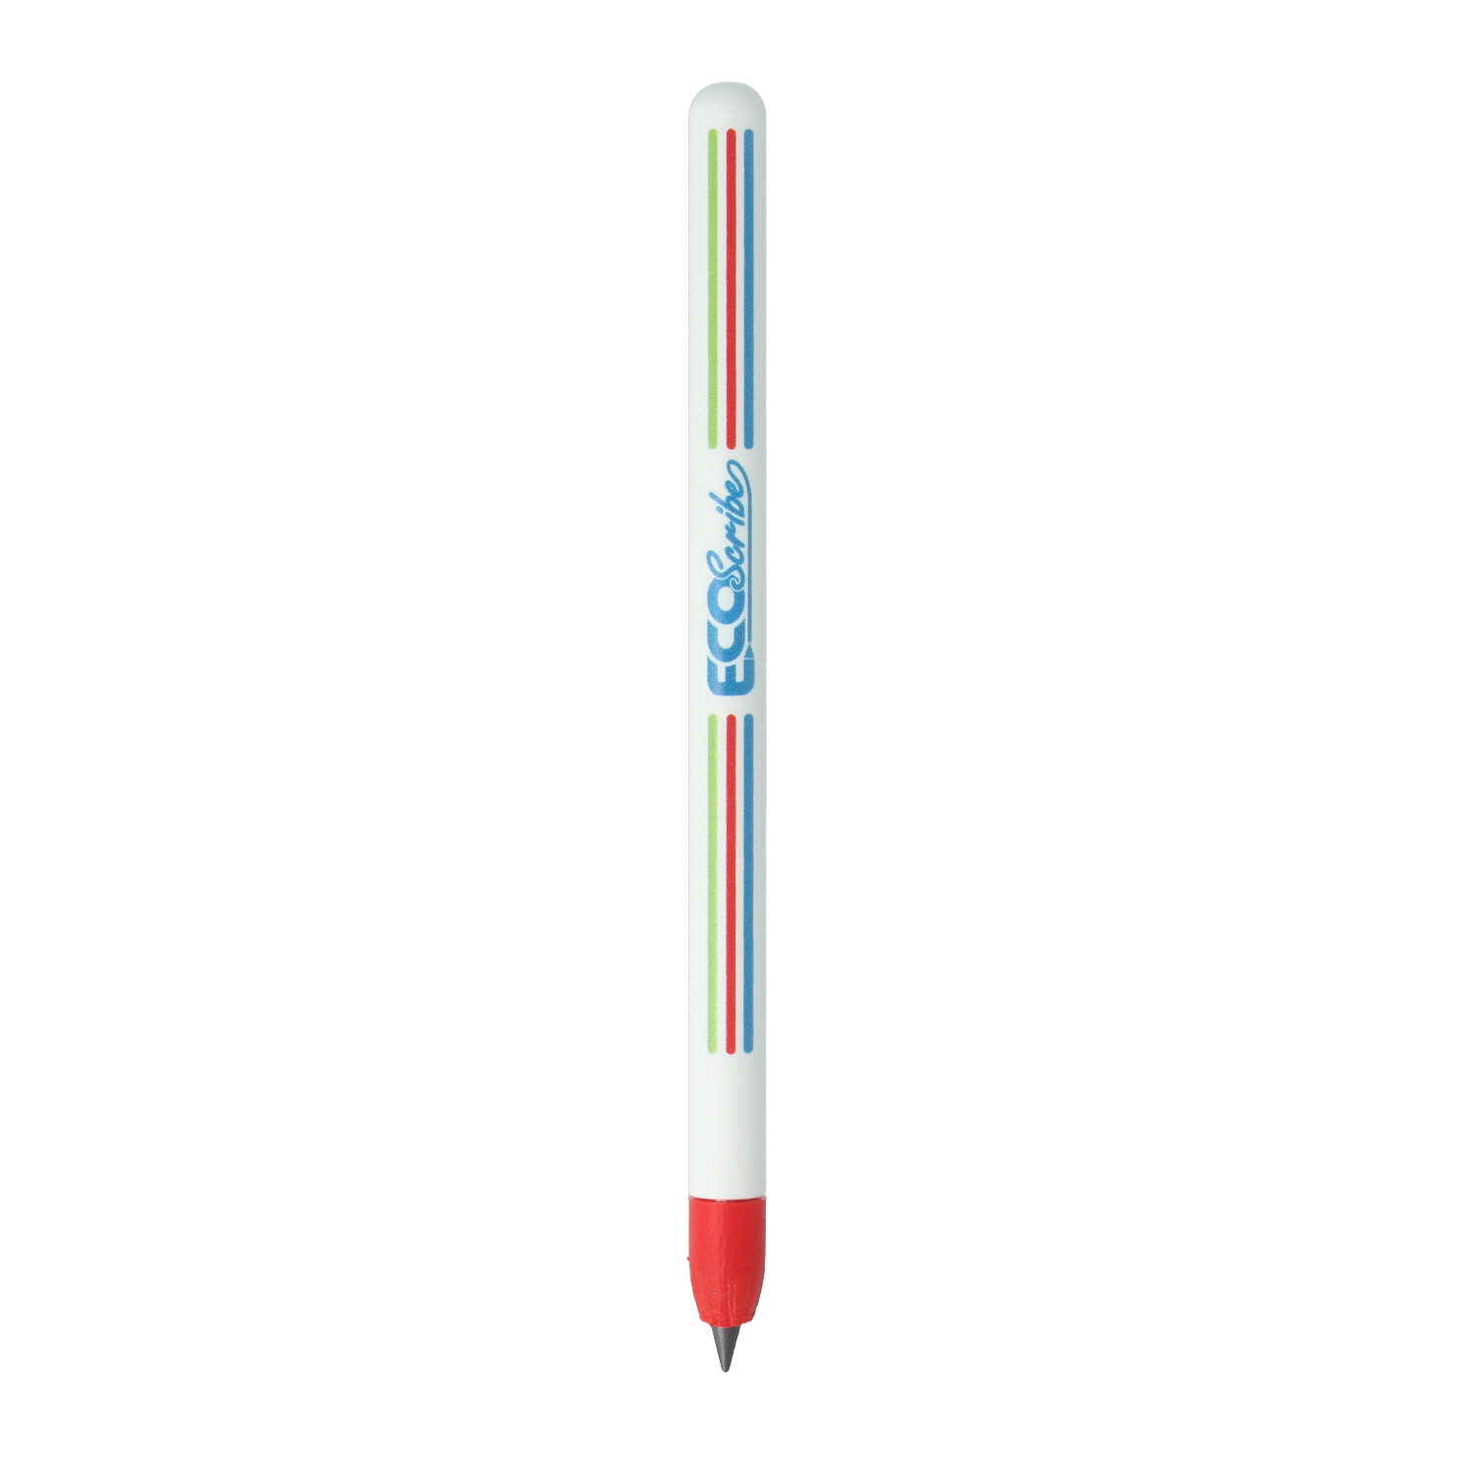

ECOSCRIBE | MAKE THE SUSTAINABLE CHOICE
Ready to elevate your
promotional merchandise?
Every promotional product you distribute carries your brand identity. EcoScribe ensures that identity reflects genuine environmental responsibility -not just in the materials you can see, but in the design choices that matter.
Get in touch to discuss your requirements and request samples.
ADD YOUR LOGO & CONTACT DETAILS HERE

