Slide 1
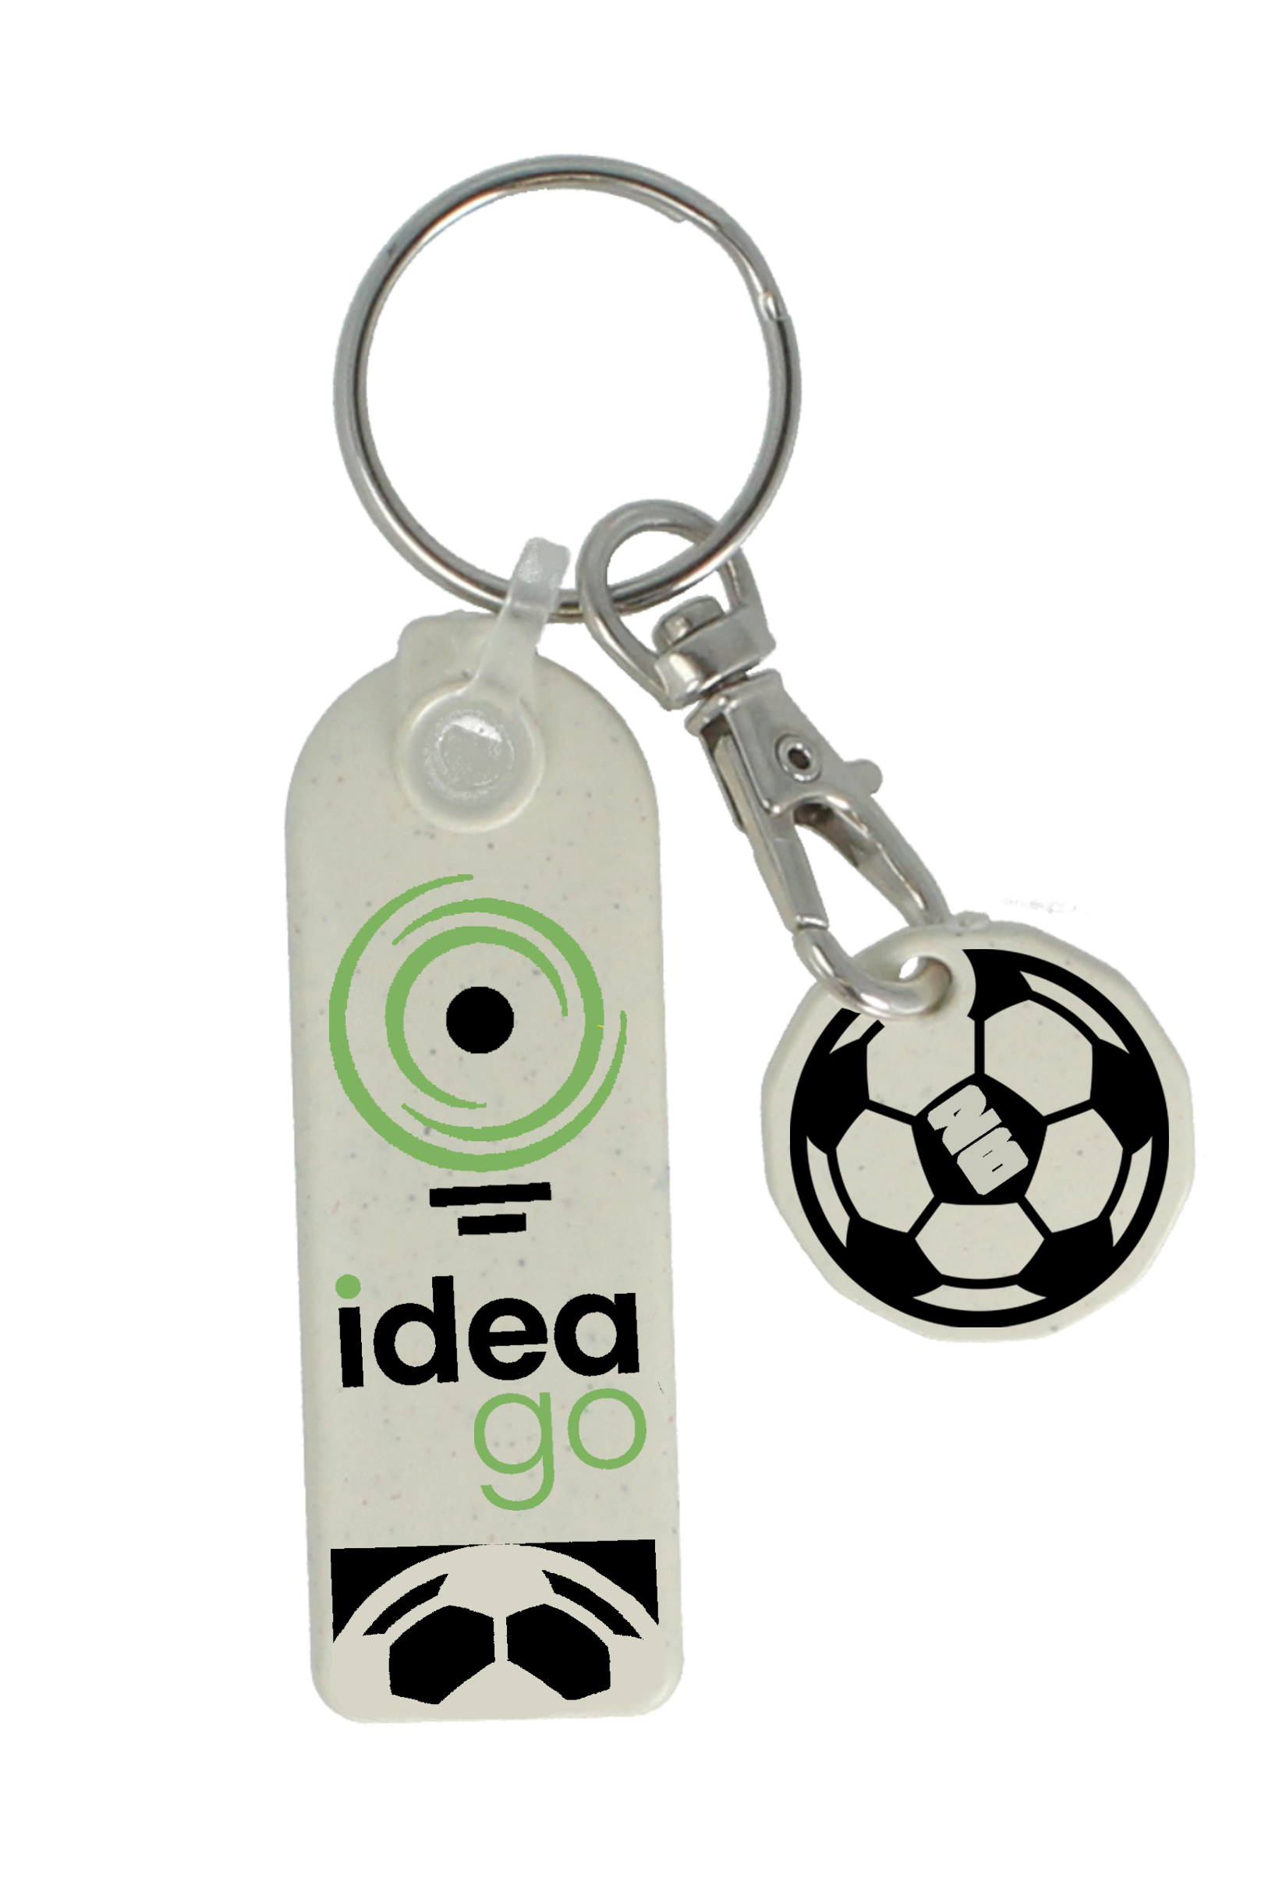

Your brand.
The biggest
sporting moments
of 2026.
YOUR LOGO HERE
2026 is one of the biggest sporting years of the decade. The FIFA World Cup, Wimbledon, The Commonwealth Games & The British Grand Prix.
We have ready-made sport-themed designs for our full sustainable merchandise range. Add your logo, your colours, your brand, and put yourself in the middle of a moment your customers already care about.
[YOUR COMPANY NAME] | [YOUR WEBSITE] | [YOUR CONTACT DETAILS]
Add your logo and branding colours before sending. Remove this note.

Slide 2
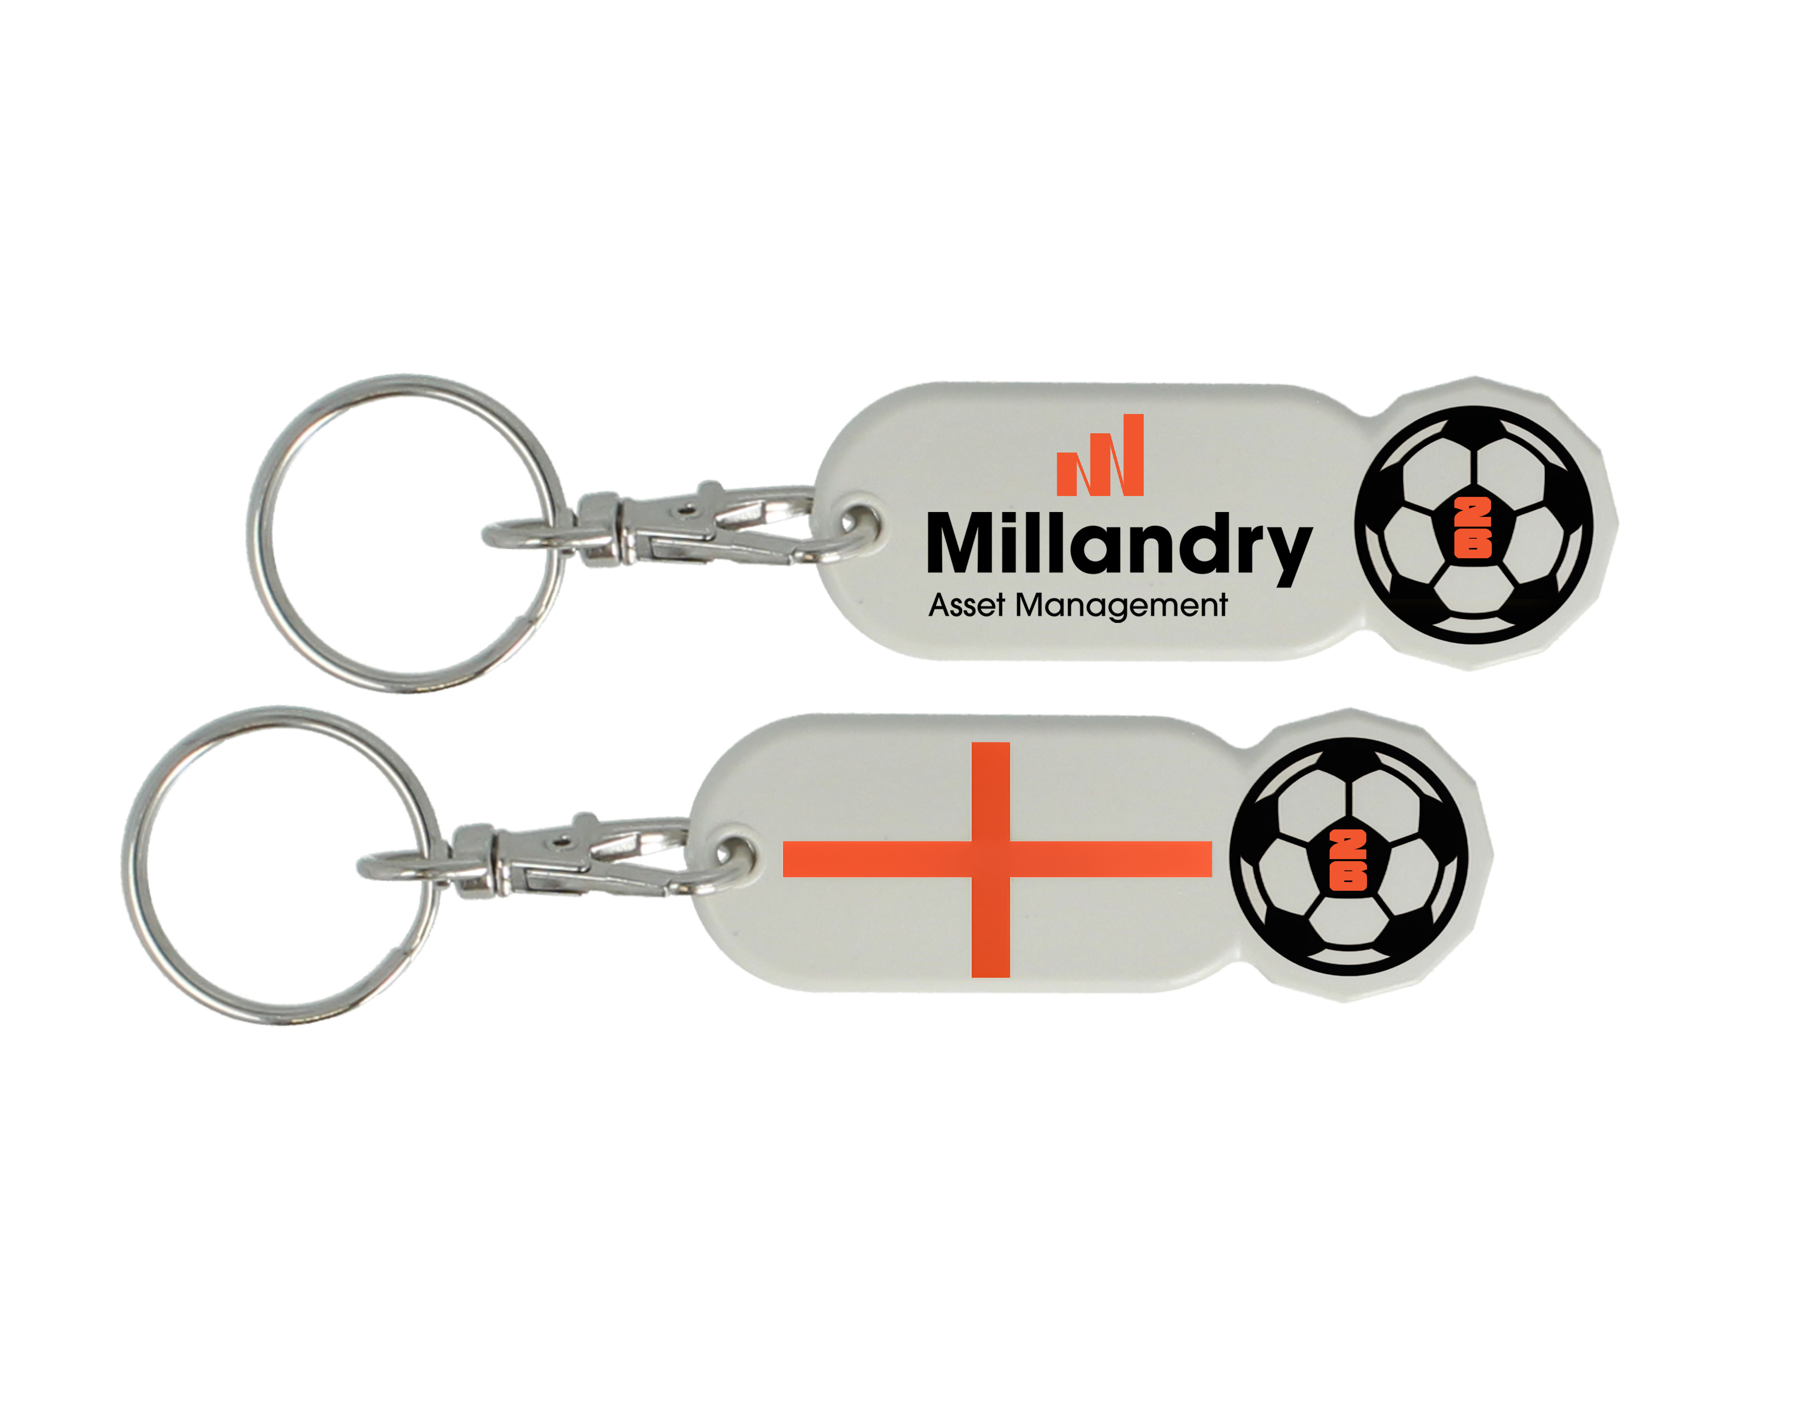



Sport-themed branded merchandise: recycled materials, made to order, made in the UK
YOUR LOGO HERE
2026 sporting highlights
Every major sport & event
FIFA World Cup
Football, tennis, rugby, golf, cricket, athletics, F1 and more. Generic sport themes or named events such as Wimbledon, the FA Cup or the World Cup.
11 June - 19 July
Wimbledon
29 June - 12 July
Your logo. Your colours.
British Grand Prix
5 July
Any design template can be combined with your branding. The sporting theme creates the context; your brand gets the recognition.
Commonwealth Games
23 July - 2 August
Any product. Any sport. Your logo.
FA Cup Final
16 May
Interested? Get in touch.
Sustainable & made to order
European Athletics Championships
Ask us for a mock-up with your logo on any product. No obligation.
All products made from recycled plastic or R+ biodegradable material in UK solar powered factory. Low MOQ, fast turnround.
10-16 August
The Open Championship
[YOUR EMAIL ADDRESS]
16-19 July
[YOUR PHONE NUMBER]
Rugby League World Cup
All products manufactured in the UK from recycled and R+ biodegradable materials. Low MOQ, fast turnaround.
[YOUR COMPANY NAME]
15 Oct - 15 Nov

